Slide 1
Amber Alley
Business Plan

Slide 2
Mission STATEMENT
Amber Alley stands at the threshold with a mission to serve below segments :
Economy :
Plan affects and ultimately renew the economic sectors.
Consumer :
Varied variety of new products available to customer.
Producer :
Enhances the production of sampled products.

Slide 3
Segment1 : Economic Development
Inception of new products and services promotes the economic activities.
Our manifesting entrepreneurial initiatives spawn new economic opportunities.
Economic Activities
Activities of Firms and Industries (Production)
Activities of localized regions (Third party services)

Slide 4
Segment 2 : Consumer Benefit
Amber Alley primarily holds a service business wholeheartedly meant for customer benefit.
Focus on different Consumer categories.
Besides potpourri of products, Information leaflets gives a value add on to customer’s purchase.
Consumer Type
Product Familiar Customer
New Customer

Slide 5
Segment 3 : Producer Benefit
Leveraging Economy and Consumer cannot subside the credit owned by creators of the product.
Product Promotion :
Services promote the product in market segments.
Product Survey :
Provides analytical and statistical product survey to the manufacturers.
New scope :
Increased edge to bring in new products to market.

Slide 6
The Team
We are a team of two members, seeding and planning the basis of ‘Amber Alley’.
As a new entrant to the retail Industry, focus is on the variety of retail products.
Start-up cost investment funds will be assets saved from prior earning of this project.
‘Debt-free’ establishment is what we are accentuating.

Slide 7
Market Summary
Amber Alley targets market for online selling of smaller products.
Our idea brings in the flurry of opportunities with present and future perspective.
As of now, this idea with its forte, frames a new segment of online selling.
A novel way of promoting and selling sample products, entices brighter future for emerging online retail chain.

Slide 8
Market Perspectives
Past View :
Considering past Indian Retail Industry, such an idea of selling sample products hasn’t commenced in true terms.
Present View :
The escalating interest of customers in making trials for new products, yields a positive response to our idea.
Future Perspective :
Being the pioneer in this segment, the idea entices multitude of customers and manufacturers as well.

Slide 9
Opportunities
Young generation loves to be highly groomed up but cannot decide what products to actually start with
Women love colors and cosmetics is implicit in their daily routine but could not decide what colors will go on their skin tone
Today, everybody is conscious about healthy eating but gets confused what to purchase from market

Slide 10
Business Concept
In the midst of the departmental store, consumers purchasing a product often gets confused that whether I should try product …
Our idea is to create a service/platform where
Consumers can try new and various products out there in market
Producers can showcase their newly launched products or their products which have lost its sheen
We will also be providing leaflet/booklet that will contain benefit and usage of the products in the box

Slide 11
Competition
In India, it will be not wrong to say that there is nothing like our idea. Its inception happened because of the same fact
Since there is no rivalry now, we have no idea about reactions/feedback of the customers
However, we understand no matter how original is the idea soon we will be having rivals and we are prepared for them

Slide 12
Goals & Objectives
To provide customers a chance to explore the market and use products actually meant for their skin/ body
To provide producer with statistical data about what customers prefer
To enhance the knowledge about various healthy edible products in the market to incorporate in the busy lifestyle
Showcase the best feedbacks from the happy customers on the website
Down the lane, to expand business and keep the full size item of the sample product.

Slide 13
Financial Plan
As Amber Alley grows, our policy will continue to focus on :
Debt-free philosophy
Start-up costs are limited to minimal equipment
Little or no staff to be paid in the beginning
Contracted companies will handle any additional investment for new products to be launched in the market
Projected Profit and Loss :
Savings : By spending less on overhead
Expenditure : Spending funds on expansion in other areas.

Slide 14
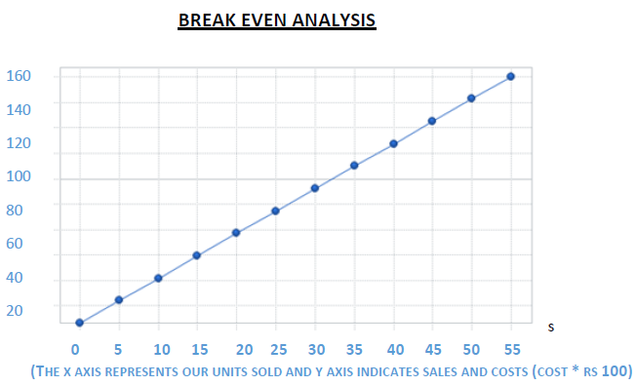
BREAK EVEN POINT

Slide 15
Resource Requirements
List of requirements for the resources
Personnel – At least 8 people are required
Technology – A server is required to run a website created from java and sql
Finances – Personal and Loans
Distribution – Warhouse and courier ??
Promotion- pamphlet distribution, promotion at shopping places, facebook, youtube, advertisement on television
Services - ??

Slide 16
Risks and Rewards
Projected Risks :
Some customers, majorly with passive interest, might not get allured by this concept of sample products.
Management :
Above risk based scenarios could be managed by offering adhoc schemes to such lesser percentage of society.
Rewards :
Once established, this business could bring miraculous demand in the customers range of product choices and in the producers area of development.

Slide 17
Key Issues
Short Term
No idea about how would current market react to this service
No assets to start the business as required
Long Term
Profit margin should be enough to run the business
Market share should be maintained
Innovative approaches have to be proportional with increasing demand of the customers

